Slide 1
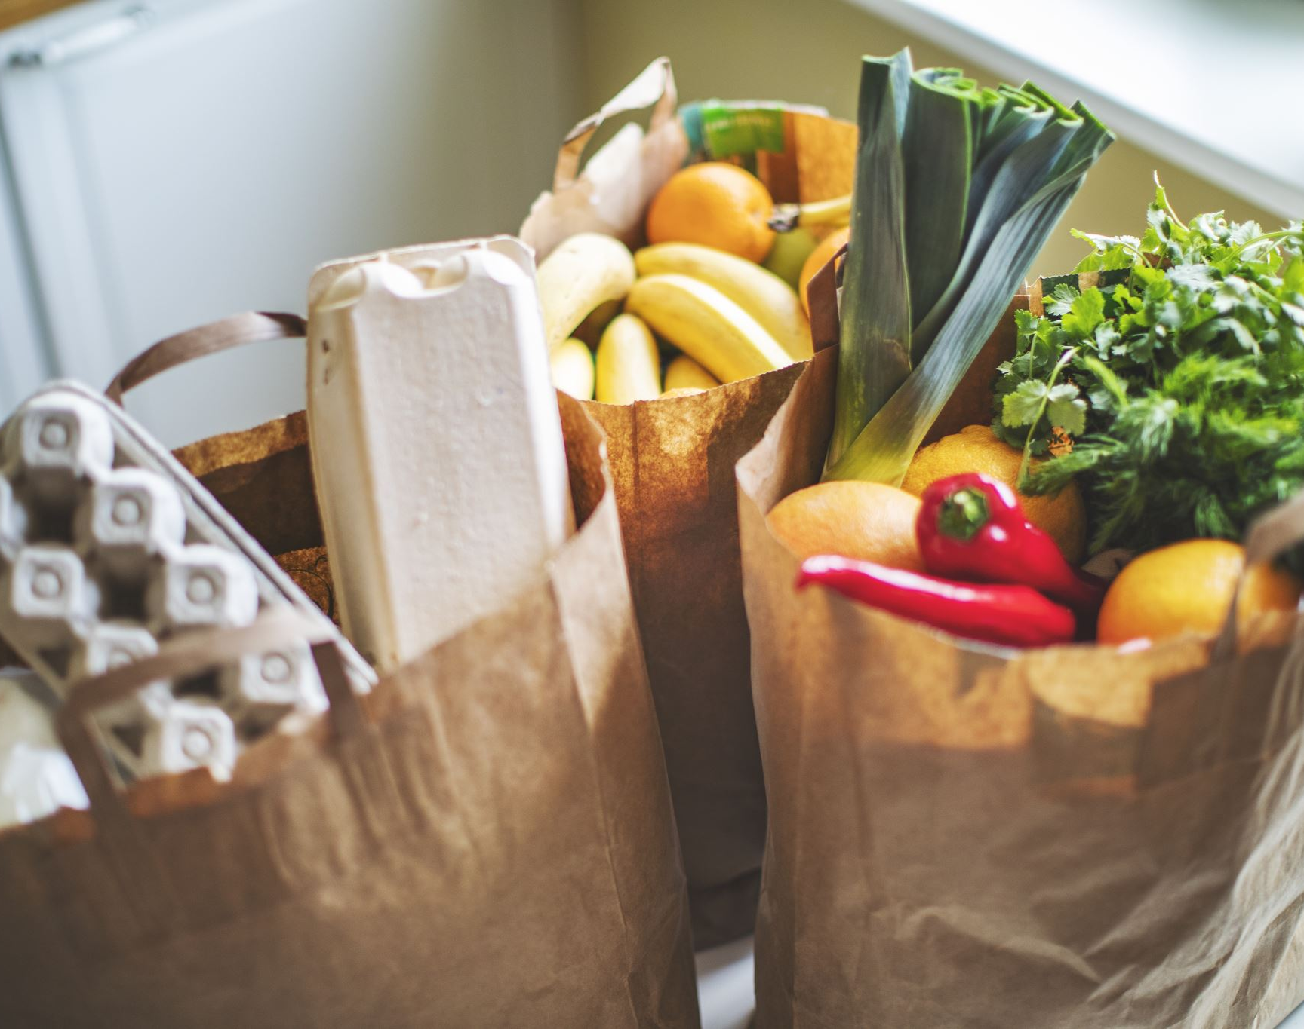
MARKETING CAMPAIGN DESIGN
Product: Zomato Food Delivery
Campaign: Food at Your Fingertips
Presented by:
G Pradeep
CSE
June 2026

Slide 2

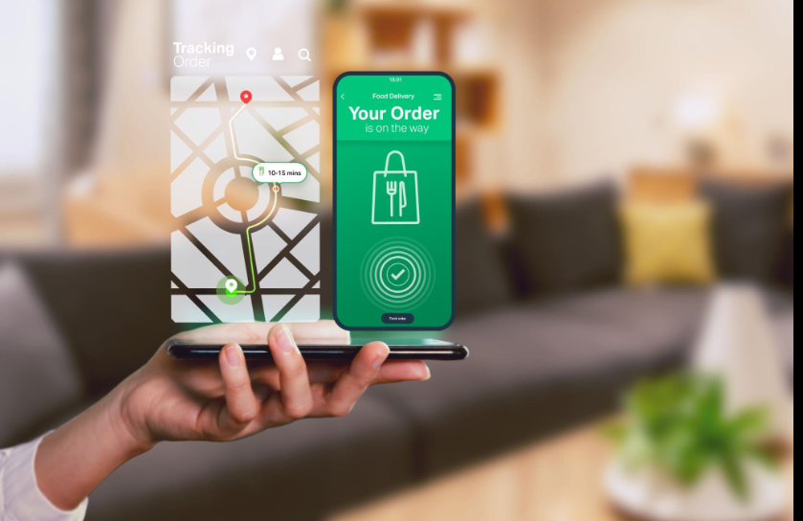
Target Audience-
College students
Working professionals
Families
Food lovers-
People who prefer online ordering
Age group: 18–40 years

Slide 3

Social Media Plan
Instagram
Food reels
Customer reviews
Discount offers
Restaurant highlights
LinkedIn
Brand updates
Business partnerships
Company achievements
YouTube
Short videos showing food experiences
Customer stories
Posting Schedule:
3–4 posts per week
Daily stories
Weekend promotional offers

Slide 4

Content Ideas
Post 1: Food Reel
Idea: Show a person ordering food and enjoying it.
Caption: “Your favourite food is just one click away! 🍕🍔”
Post 2: Customer Experience
Idea: Share customer feedback and reviews.
Caption: “Good food creates happy moments ❤️”
Post 3: Offer Campaign
Idea: Weekend discount promotion.
Caption: “Weekend cravings? Get your favourite meals delivered!”

Slide 5
Advertisement Strategy
Run Instagram and Facebook ads.
Use food-related videos and attractive visuals.
Promote discounts and special offers.
Collaborate with food influencers.
Target users based on location and interests.

Slide 6
Budget Estimate
Total Budget: ₹70,000
Activity | Estimated Budget
Social Media Ads | ₹20,000
Influencer Promotion | ₹15,000
Content Creation | ₹10,000
Offers & Promotions | ₹25,000

Slide 7

Expected Results
Increase brand awareness.
More app downloads.
Higher customer engagement.
Increased food orders.
Better customer loyalty.

Slide 8
Conclusion
The “Food at Your Fingertips” campaign helps Zomato connect with customers through creative content, social media marketing, and promotional strategies. This campaign can improve engagement and strengthen the brand image.

Slide 9
THANK YOU

